Slide 1
IBM University Engagement Project Submission
“Exploring the Power of Agentic AI with IBM Granite and IBM Bob”

Slide 2

Project Tile – Social Media AI Agent
Domain of Project – AI-powered Social Media Analytics and Content Generation Platform
Student Name | Recent Passport Photo | Email ID | Mobile number [WhatsApp]
Aryan Deepak Shete |  | shetearyan479@gmail.com | 7507505880
Recommended font style and size: Font Style: Arial Font Size (Heading): 28
Font Size (Content): 20

Slide 3
Problem Statement -
Problem Statement : social media agent
Social media platforms generate massive amounts of content every minute, making it difficult for brands, influencers, and organizations to monitor trends, understand audience sentiment, track competitors, and create engaging content consistently. Managing multiple platforms often results in scattered insights, delayed responses, and ineffective marketing decisions.
The objective of this project is to develop an AI-powered Social Media Intelligence Agent that consolidates data from platforms such as X, LinkedIn, Instagram, and Facebook into a single intelligent system. The agent uses IBM Langflow / IBM Orchestrate and IBM Foundation Models to analyze trends, monitor audience sentiment, generate creative social media content, recommend the best posting times, and provide actionable insights through an interactive dashboard. By combining predictive analytics with AI-driven content generation, the solution helps users improve engagement, optimize campaigns, and make faster, data-driven social media decisions.

Slide 4
Proposed Solution -
The proposed solution is an AI-powered Social Media Intelligence Agent that acts as an intelligent assistant for brands, influencers, and organizations to simplify social media management. The agent integrates data from multiple social media platforms, including X, LinkedIn, Instagram, and Facebook, and transforms it into meaningful, actionable insights.
Using IBM Langflow / IBM Orchestrate and IBM Foundation Models, the agent enables users to interact through text, images, or voice to generate engaging social media posts, captions, campaign ideas, and hashtag recommendations tailored to their brand identity. It also analyzes audience sentiment, monitors competitor activities, predicts trending topics and engagement patterns, and recommends the best posting schedules to maximize reach.
A real-time analytics dashboard provides visual insights into engagement trends, influencer activity, campaign performance, and audience sentiment. By combining AI-driven content creation, predictive analytics, and intelligent recommendations, the solution helps users save time, improve engagement, and make data-driven decisions for more effective social media marketing.

Slide 5
Technology Used
IBM Bob platform -For designing and orchestrating multi-agent workflows visually
IBM Grainte model - for eg – ibm-granite-3-2-8b – For natural language understanding, reasoning, and personalization
IBM Cloud – It provides the infrastructure to build, deploy, and scale the Nutrition Agent efficiently. IBM Cloud enables a reliable, secure, and scalable environment for deploying the Nutrition Agent.
RAG– RAG to fetch real data first, then generate intelligent answers, making the Nutrition Agent more trustworthy and effective.
IBM Watsonx.ai - For model deployment, embeddings, and AI governance
Vector Database (FAISS/Chroma) – For RAG-based nutritional data retrieval

Slide 6
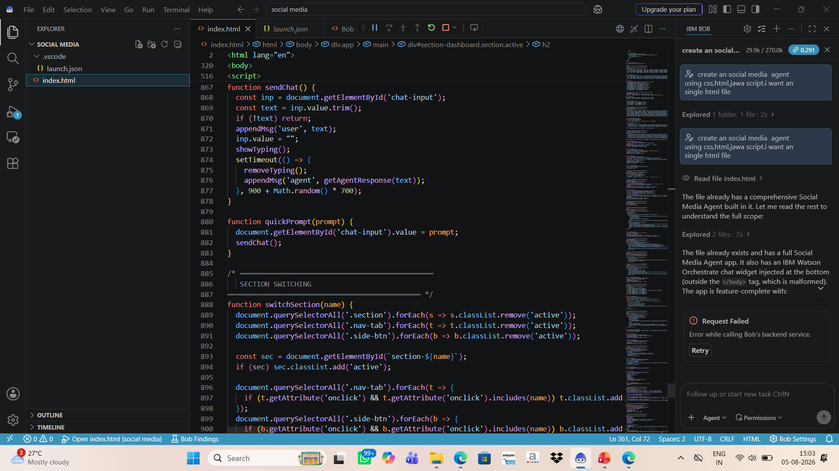
Required Files created using IBM bob -
Index.html

Slide 7
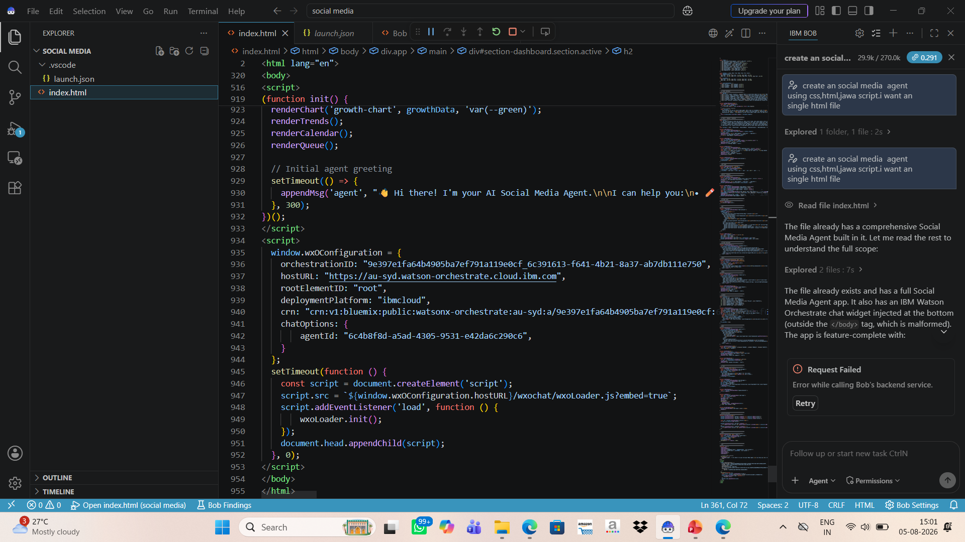
IBM Bob Screenshots:

Slide 8

Architecture blueprint for IBM bob:

Slide 9

Role of Agentic AI in the solution
Role of Agentic AI in Nutrition Agent
The Agentic AI serves as the intelligent decision-making core of the Social Media Intelligence Agent. Unlike traditional AI systems that only respond to user queries, Agentic AI can analyze information, reason, make recommendations, and proactively assist users in achieving their social media goals.

Slide 10


Token Usage
11,761 token are used
Before Prompt
After the Prompt
·
·
·

Slide 11
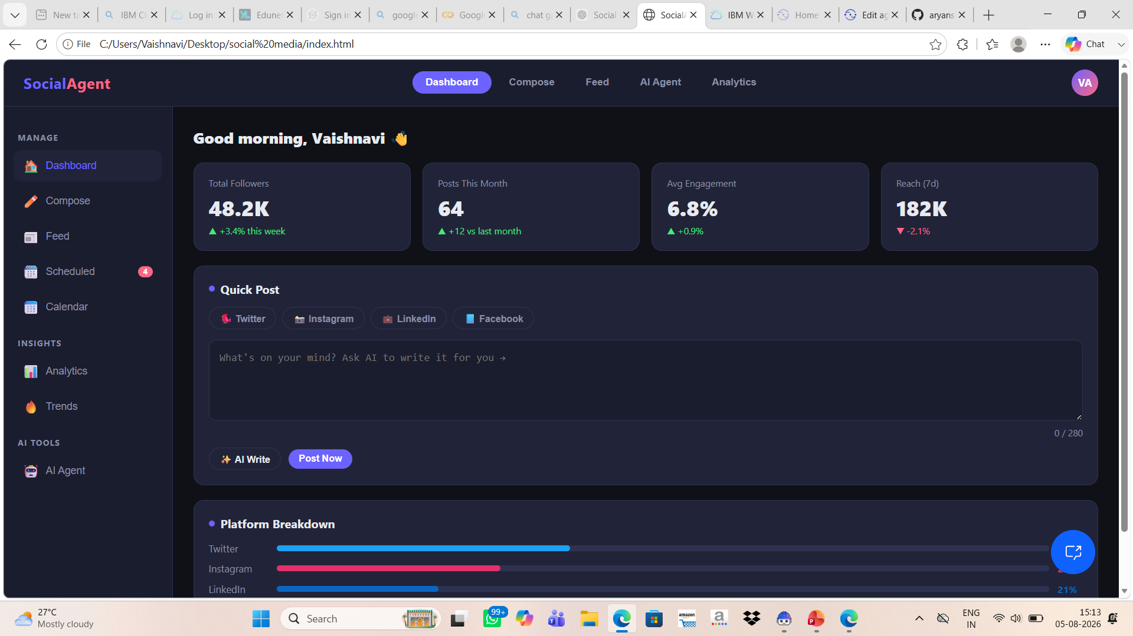
Project Output Screenshot
Please put IBM Bob output screenshots with 2-3 prompts.
You can take 2-3 more slides for each screenshot
·
·
·

Slide 12
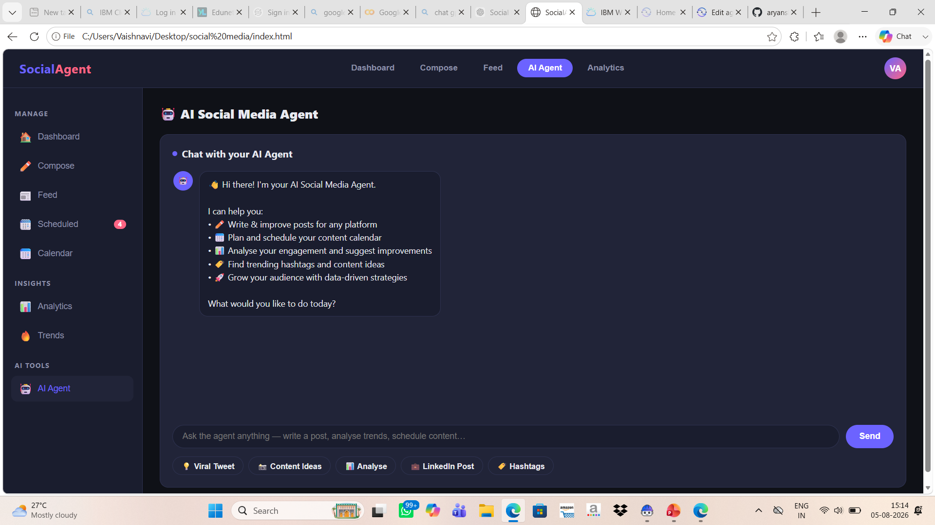
Project Output Screenshot
Please put IBM Bob output screenshots with 2-3 prompts.
You can take 2-3 more slides for each screenshot
·
·
·

Slide 13
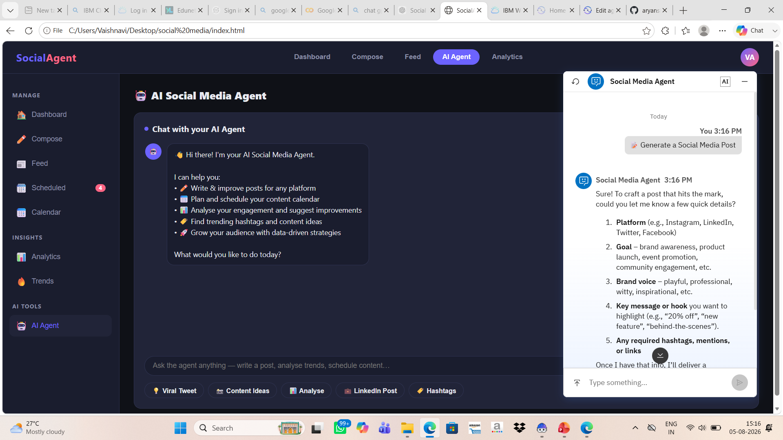
Project Output Screenshot
Please put IBM Bob output screenshots with 2-3 prompts.
You can take 2-3 more slides for each screenshot
·
·
·

Slide 14
Novelty and Uniqueness
The Social Media Intelligence Agent stands out by combining multichannel analytics, generative AI, predictive intelligence, and multimodal interaction into a single platform. Unlike traditional social media management tools that mainly focus on scheduling posts or displaying analytics, this solution acts as an intelligent AI assistant that not only analyzes data but also recommends actions and generates content in real time.

Slide 15
Git Hub Link
https://github.com/aryanshete25-dotcom/SOCIAL_MEDIA.git
·
·
·

Slide 16
Future Scope
Support for More Platforms: Extend support to platforms such as TikTok, YouTube, Pinterest, and Reddit.
Automated Publishing: Enable direct scheduling and automatic posting across multiple social media platforms.
Advanced AI Insights: Use machine learning to improve trend prediction, engagement forecasting, and audience behavior analysis.
Personalized Content Strategy: Generate customized content calendars based on user preferences, target audience, and campaign goals.
Influencer Collaboration: Recommend suitable influencers based on audience demographics, engagement, and campaign objectives.
·
·
·

Slide 17
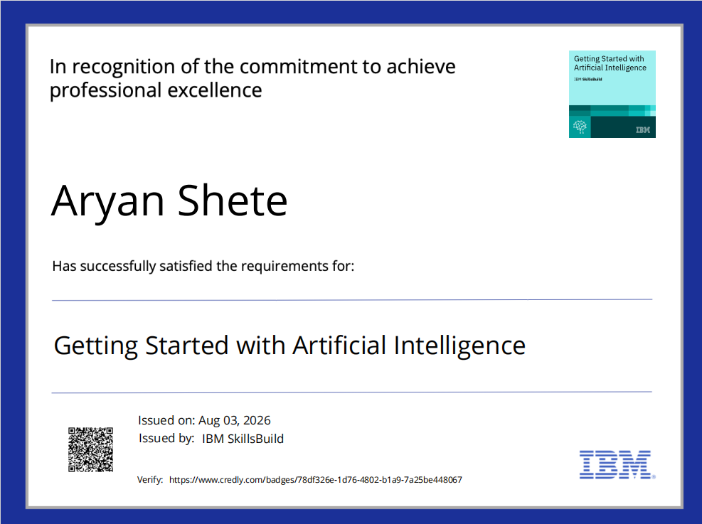
Certificates Earned:

Slide 18
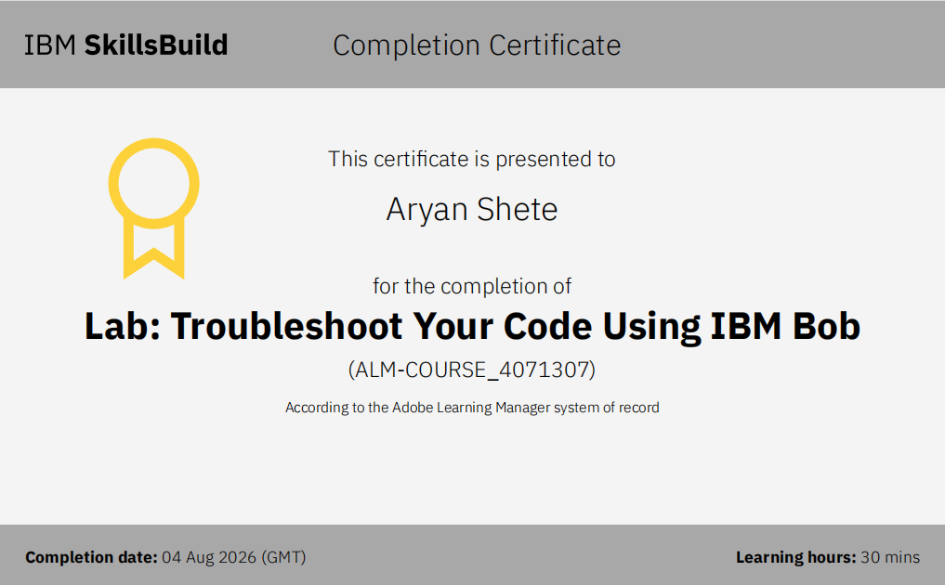
Certificates Earned:​

Slide 19


